Slide 1
Physical Pharmacy
(PT 203)/ (CPT 203)
Lab 5
Determination of Critical Micelle Concentration

Slide 2
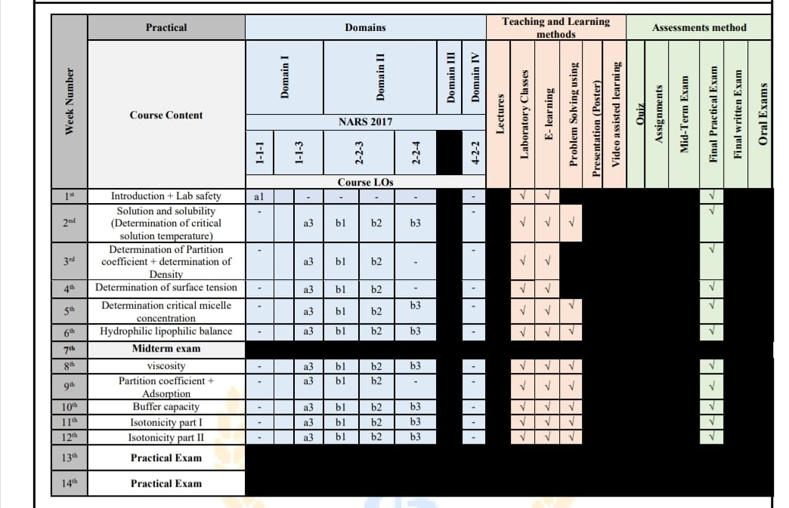

Slide 3
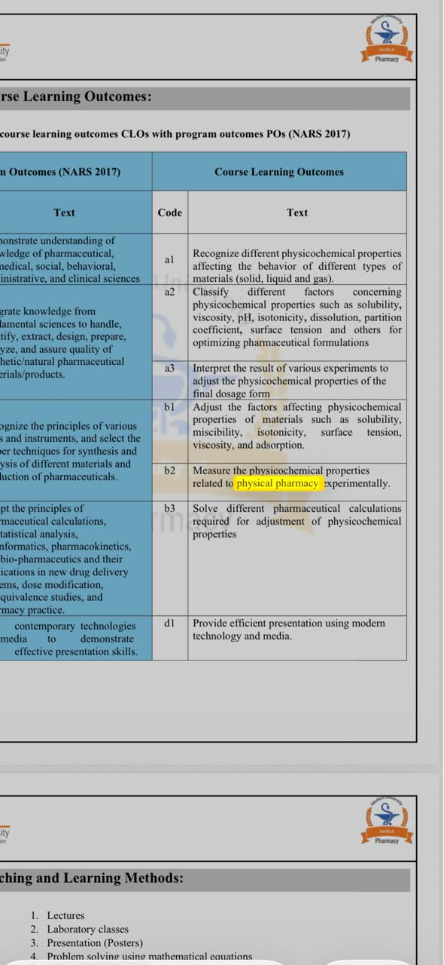

Slide 4
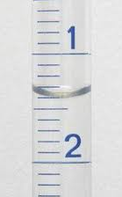
Surface tension and interfacial tension phenomena
Surface:
Is the boundary between two phases one of them is gas or vacuum.
Interface:
Is the boundary between two phases which are immiscible.
N.B: Every surface is interface.

Slide 5
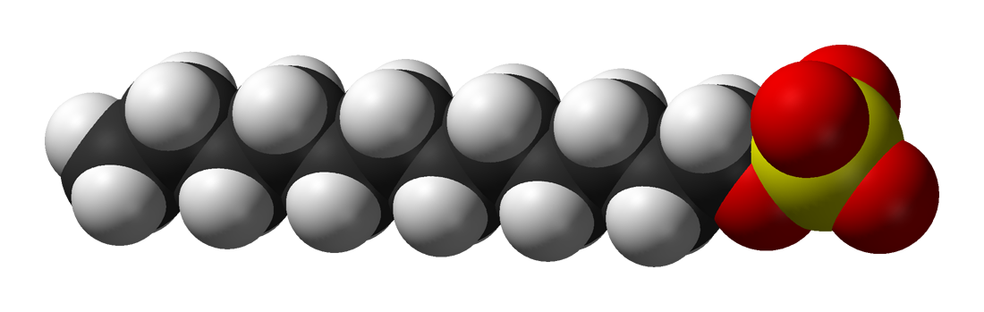
Surface active agent (Surfactants)
Hydrophilic head
(lypophobic)
Hydrophobic tail (lypophilic)
Surfactants are amphiphilic compounds with two opposing portions, one part is hydrophilic and the other is hydrophobic that decrease the surface tension or interfacial tension between two liquids, a liquid and a gas, or a liquid and a solid.

Slide 6
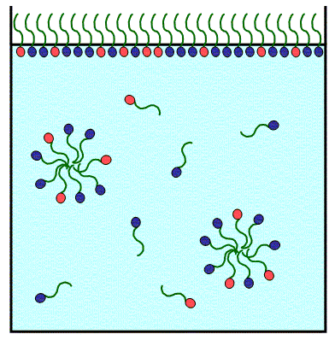
Micelle formation:
Critical micelle concentration
defined as the concentration of surfactants above which micelles form and all additional surfactants added to the system will form micelles.

Slide 7
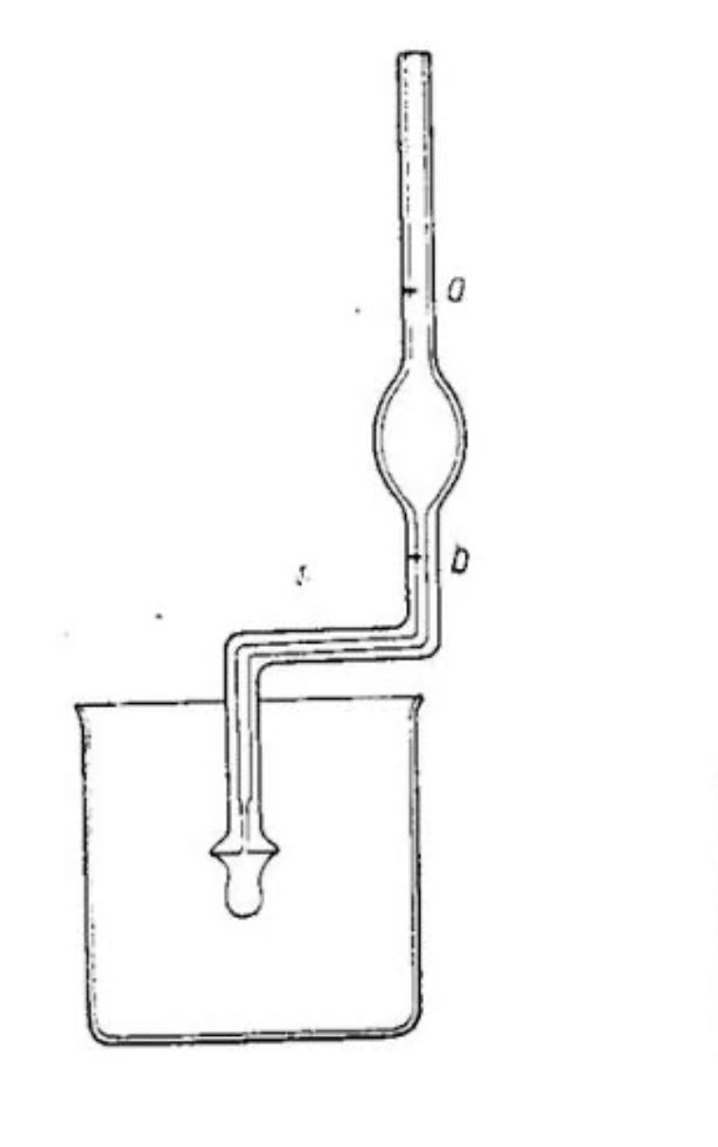
Measurement of surface tension Drop weight method
Procedure:
1-Wash the stalagmometer with the water
2- fill it with the water placed in a beaker or conical measure.
3- Withdraw the water slowly to avoid air bubbles introduction till the upper mark then close it.
4-Dry the nozzle of the stalagmometer with a tissue.
5-put the stalagmometer in a vertical position and allow water to fall from the upper mark to the lower mark and count the drops.
5- Repeat the experiment three times for water and record the three readings and take an average for them:
(N₁+ N₂+ N₃) / 3
6- Repeat the same procedure with the tested solutions.
7- calculate the surface tension of the liquids by applying the above equation.

Slide 8
Example: Calculate the surface tension of each solution then draw a graph for the results and determine the CMC
Solution No. | Conc. (%) | No. of Drops |  |  | Surface Tension (dyne/cm)
 |  | I | II | III
1 (water) | 0 | 75 | 74 | 75 | 72.8
2 (Sol^{n} 1) | 0.1 | 83 | 82 | 84
3 (Sol^{n} 2) | 0.2 | 95 | 96 | 96
4 (Sol^{n} 3) | 0.3 | 103 | 102 | 103
5 (Sol^{n} 4) | 0.4 | 103 | 104 | 105
6 (Sol^{n} 5) | 0.5 | 105 | 104 | 104

Slide 9
Measurement of surface tension Drop weight method
ɣ ₁ / ɣ ₂ = n₂ / n₁
Unit :
erg/cm² or dyne/cm
No. of water drops
ɣ=
X surface tension of water
(ɣ =72.8)
No. of liquid drops

Slide 10


Slide 11
Critical Micelle concentration (CMC)
S.T (dyne/cm)
SAA conc. (%)

Slide 12
Solution No. | Conc. (%) | Average no. of Drops | Surface Tension (dyne/cm)
1 (water) | 0 |  | 72.8
2 (Sol^{n} 1) | 0.02
3 (Sol^{n} 2) | 0.04
4 (Sol^{n} 3) | 0.1
5 (Sol^{n} 4) | 0.15
6 (Sol^{n} 5) | 0.2

Slide 13
Critical Micelle concentration (CMC)
S.T (dyne/cm)
SAA conc. (%)

Slide 14


